Slide 1

‘xz’ command
Course Code: CUTM1032
Credits : (1-1-1)
Presented by:
M.Mahesh Babu
22180130024

Slide 2
INTRODUCTION TO XZ COMMAND
Compression:
xz filename: Compresses filename to filename.xz.
Decompression:
xz -d filename.xz: Decompresses filename.xz to filename.
Options:
-k (keep original), -v (verbose), -9 (maximum compression), -c (write to stdout), -t (test), -z (force compression), -d (decompress).

Slide 3
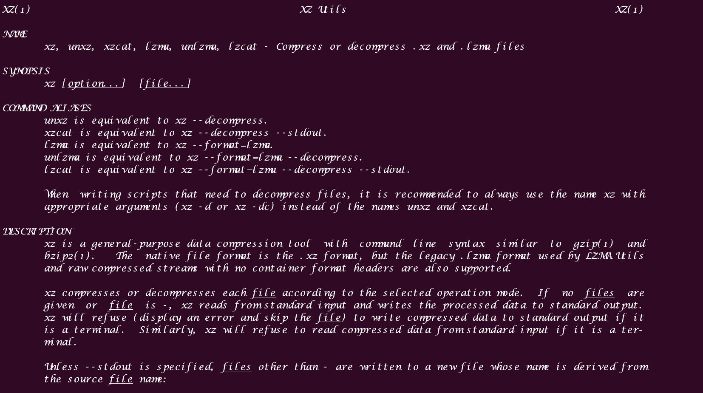
MANUAL PAGE OF XZ

Slide 4
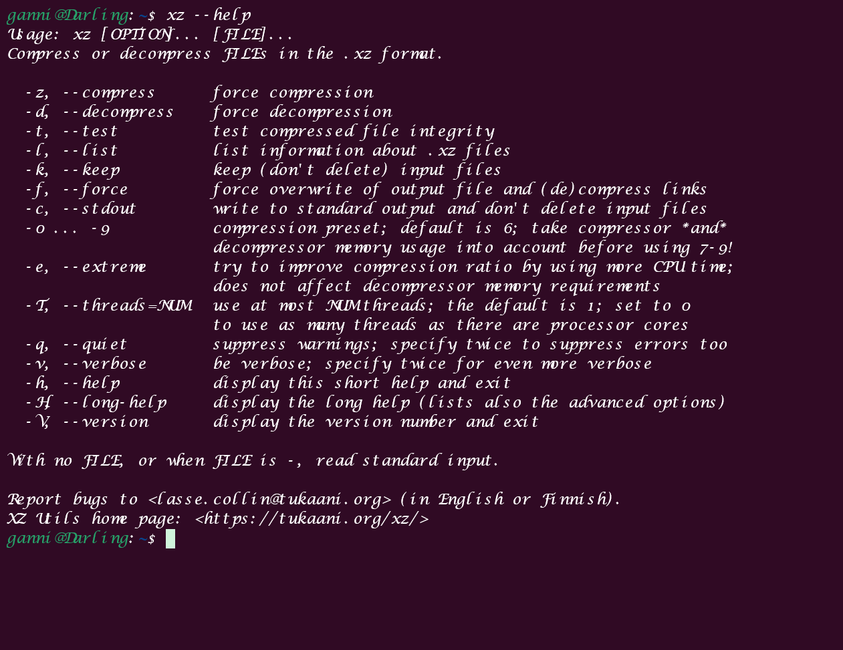
xz OPTIONS

Slide 5
EXECUTION
.txt file
> operator
cp command
-v option
-dk option (-d,-k)
ls -g

Slide 6



OUTPUT SCREENS

Slide 7
Operators
Shell is an interface using which the programmer can execute command and interact directly to the operating system. Shell scripting is giving commands that a shell can execute.
In shell also there are variables and operators that are used to manipulate these variables. There are 5 basic operators in shell scripting.
Arithmetic Operators
Relational Operators
Boolean Operators
Bitwise Operators
File Test Operators

Slide 8
1.Arithmatic operator Addition: + Subtraction: - Multiplication: * Division: / Modulus : % 2.Relational Operator Equal to: == Not equal to: != Greater than: > Less than: < Greater than or equal to: >= Less than or equal to: <=

Slide 9
3.Boolean Operator Logical AND: && Logical OR: || Logical NOT: ! 4.Bitwise Operator Bitwise AND: & Bitwise OR: | Bitwise XOR (Exclusive OR): ^ Bitwise NOT (Complement): ~ Left Shift: << Right Shift: >> 5.File Text Operator -b operator -s operator -r operator -w operator -x operator

Slide 10
Thank you

